Slide 1


Green Pace
Security Policy Presentation
Developer: Michael Gontarek

Slide 2

OVERVIEW: DEFENSE IN DEPTH

Slide 3
THREATS MATRIX
It is important that we look at the threats matrix to know what areas of our code to focus on for security and costs.
Likely Threat that is very likely to happen. | Priority High severity, likely, inexpensive to repair flaws.
Low priority Low severity, unlikely, expensive to repair flaws. | Unlikely Threat that is not likely to happen.

Slide 4
10 PRINCIPLES
Validate Input Data
Allocate sufficient memory for an object.
Use valid integer ranges.
Heed Compiler Warnings
Do not attempt to create a std:string from a null pointer.
Architect and Design for Security Policies
Keep It Simple
Range check element access.
Default Deny
Adhere to the Principle of Least Privilege
Sanitize Data Sent to Other Systems
Practice Defense in Depth
Guarantee exception safety.
Close files when they are no longer needed.
Use Effective Quality Assurance Techniques
Incorporate diagnostic tests using assertions.
Adopt a Secure Coding Standard
Ensure that operations on signed integers do not result in overflow.
Do not add or subtract an integer to a pointer to a non-array object.
Guarantee that library functions do not overflow.

Slide 5
CODING STANDARDS
Ensure that operations on signed integers do not result in overflow.
Guarantee exception safety.
Use valid iterator ranges.
Allocate sufficient memory for an object.
Do not attempt to create a std::string from a null pointer.
Guarantee that library functions do not overflow.
Range check element access.
Do not add or subtract an integer to a pointer to a non-array object.
Close files when they are no longer needed.
Incorporate diagnostic tests using assertions.

Slide 6
ENCRYPTION POLICIES
At rest
This is designed to prevent attackers from accessing data that is unencrypted by ensuring that data is encrypted when not being used. Such as databases, data warehouses, spreadsheets, archives, etc.
In flight
This is data that is being encrypted when it’s being transmitted over a network.
In use
Data needs to be secure by making sure we are only authorizing the proper users to certain data. We ensure data is protected by using the principle of least privilege.

Slide 7
TRIPLE-A POLICIES
Authentication
Identifies a user and ensures they have access to certain applications and data. Typically verified with some sort of userID and password.
Autrhorization
Enforce policies such as, determining the activities, resources, or services a user can use.
Accounting
Recording the activity of users during access to different networks or applications. This way we can look back to see what data was looked at and by who if we have a breach.

Slide 8
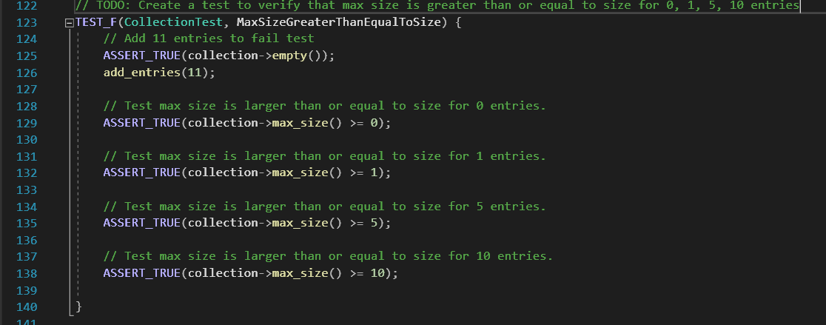
Add to empty vector

Slide 9
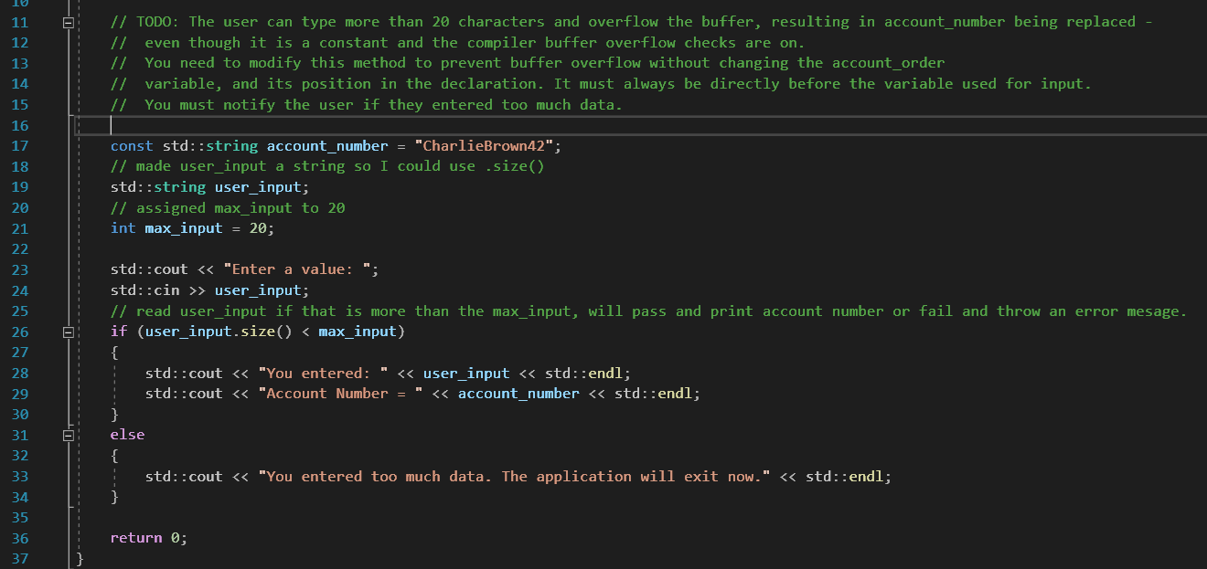
Buffer Overflow

Slide 10

AUTOMATION SUMMARY

Slide 11
TOOLS
DevOps is an extension to the SDLC. We focus on security at every level of development. This includes the plan, designing, building and testing phase. This continues into maintaining as well as when we monitor and detect issues in the code.
Tools we can use to ensure we are writing clean and safe code are, SonarQube, Coverity, CppCheck, and Clang-Tidy. These tools allow us to get some more insight than what Visual Studio may be offering. The more tools we use to help us find mistakes the better!

Slide 12
RISKS AND BENEFITS
Security is something that takes time and money to implement. So, what we want to ensure is that as we develop, we are also using secure coding standards and tests within our code. This will help cut down on used resources later.
Risks and benefits of act now and wait.
Wait
Cost less and takes less upfront effort
Faster production
Act now
Cost more and takes more upfront effort
Slower production but save headaches later.
We need to ensure that we are acting now. This will ensure that we don’t have data breaches later down the road that affects our reputation and customers.

Slide 13
RECOMMENDATIONS
We need to ensure we are up to date on all the current threats and trends of hackers. Doing this will help ensure Green Pace is safe and secure along with our customers. When writing good safe code, we need to remember to keep it simple so that we can update easily.
Yahoo was hacked by a simple phishing

Slide 14
CONCLUSIONS
The principles and standards mentioned though out this presentation will help ensure that we keep Green Pace and our customers safe from data breaches. We must always think about what a hacker may do to exploit our system and how we can protect it. By using the zero-trust methodology, we can make sure that no one has access to any data unless it was given to them at some point. By following the principals and standards here we can keep Green Pace and our customers data safe.

Slide 15
REFERENCES
Williams, M. (2022). Inside the Russian hack of Yahoo: How they did it. CSO Online. Retrieved 9 April 2022, from https://www.csoonline.com/article/3180762/inside-the-russian-hack-of-yahoo-how-they-did-it.html.

